Slide 1
Capstone Project of Coursera The Battle of Neighborhoods | Finding a Better Place in Scarborough
From:
Rachna Jain

Slide 2
1. Introduction
The purpose of this project is to help people in exploring better facilities around their neighborhood. It will help people making smart and efficient decisions on selecting great neighborhoods out of numbers of other neighborhoods in Scarborough, Toronto.
Lots of people are migrating to various states of Canada and needed lots of research for good housing prices and reputed schools for their children. This project is for those people who are looking for better neighborhoods. For ease of accessing to Cafe, School, Supermarket, medical shops, grocery shops, mall, theatre, hospital, like-minded people, etc.
This Project aims to create an analysis of features for people migrating to Scarborough to search the best neighborhood as a comparative analysis between neighborhoods. The features include median housing price and better school according to ratings, crime rates of that particular area, road connectivity, weather conditions, good management for an emergency, water resources both fresh and wastewater and excrement conveyed in sewers and recreational facilities.
It will help people to get the awareness of the area and neighborhood before moving to a new city, state, country or place for their work or to start a new fresh life.

Slide 3
2. Data Section Data Link: https://en.wikipedia.org/wiki/List_of_postal_codes_of_Canada:_M
Will use the Scarborough dataset which we scrapped from Wikipedia on Week 3. Dataset consisting of latitude and longitude, zip codes.
Foursquare API Data:
We will need data about different venues in different neighborhoods of that specific borough. In order to gain that information, we will use “Foursquare” locational information. Foursquare is a location data provider with information about all manner of venues and events within an area of interest. Such information includes venue names, locations, menus, and even photos. As such, the foursquare location platform will be used as the sole data source since all the stated required information can be obtained through the API.
After finding the list of neighborhoods, we then connect to the Foursquare API to gather information about venues inside each and every neighborhood. For each neighborhood, we have chosen the radius to be 100 meters.
The data retrieved from Foursquare contained information of venues within a specified distance of the longitude and latitude of the postcodes. The information obtained per venue as follows:
Neighborhood
Neighborhood Latitude
Neighborhood Longitude
Venue
Name of the venue e.g. the name of a store or restaurant
Venue Latitude
Venue Longitude
Venue Category

Slide 4
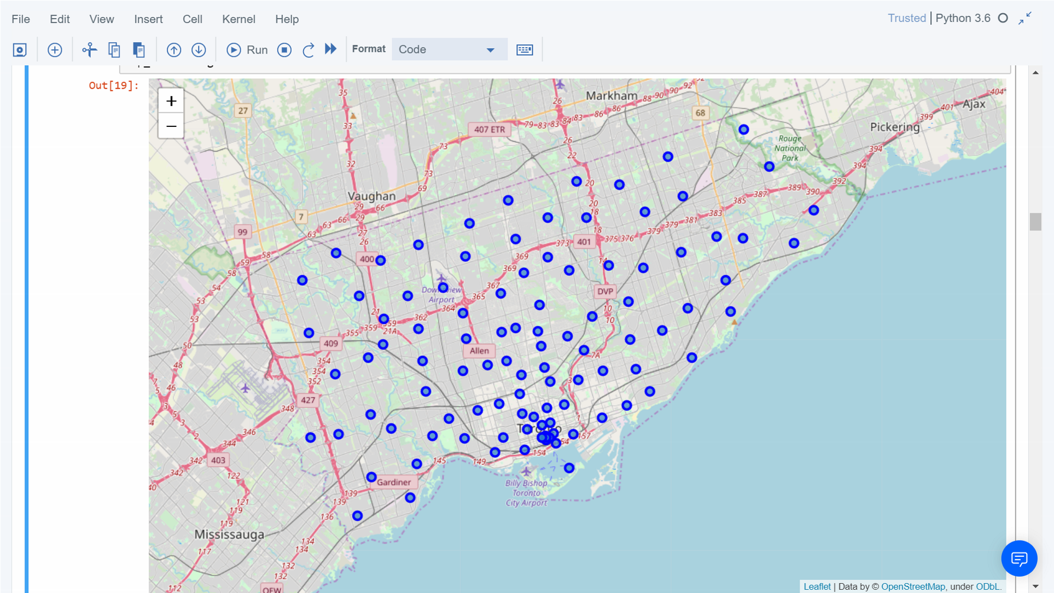
Map of Scarborough

Slide 5
3. Methodology Section
Clustering Approach:
To compare the similarities of two cities, we decided to explore neighborhoods, segment them, and group them into clusters to find similar neighborhoods in a big city like New York and Toronto. To be able to do that, we need to cluster data which is a form of unsupervised machine learning: k-means clustering algorithm.

Slide 6
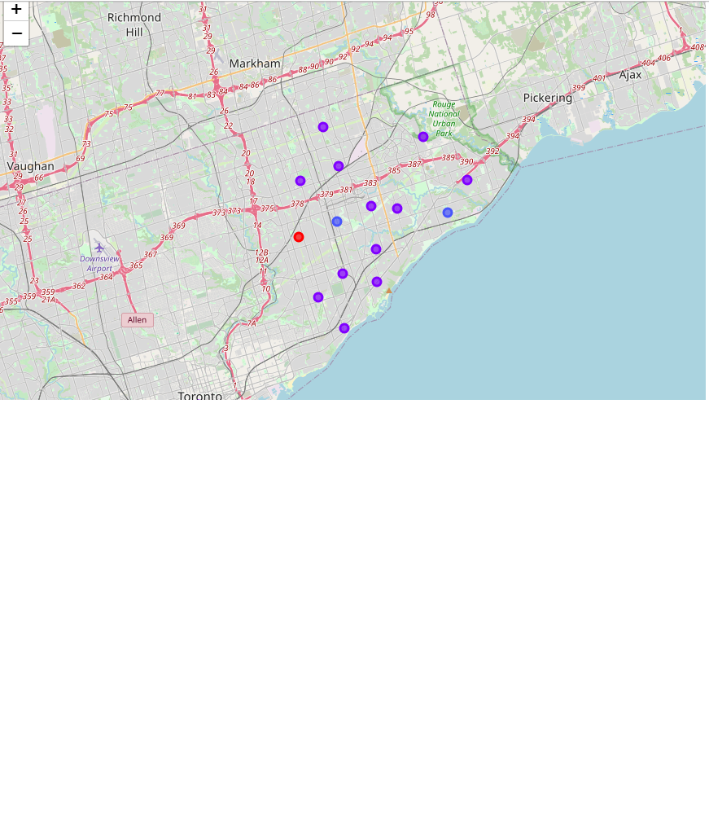
Using K-Means Clustering Approach

Slide 7
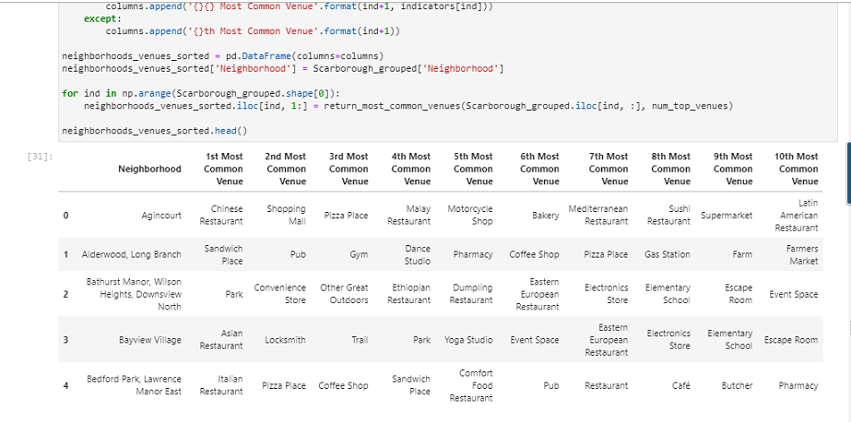
Most Common venues near Neighborhood:

Slide 8
Work Flow:
Using credentials of Foursquare API features of near-by places of the neighborhoods would be mined. Due to http request limitations the number of places per neighborhood parameter would reasonably be set to 100 and the radius parameter would be set to 500.

Slide 9
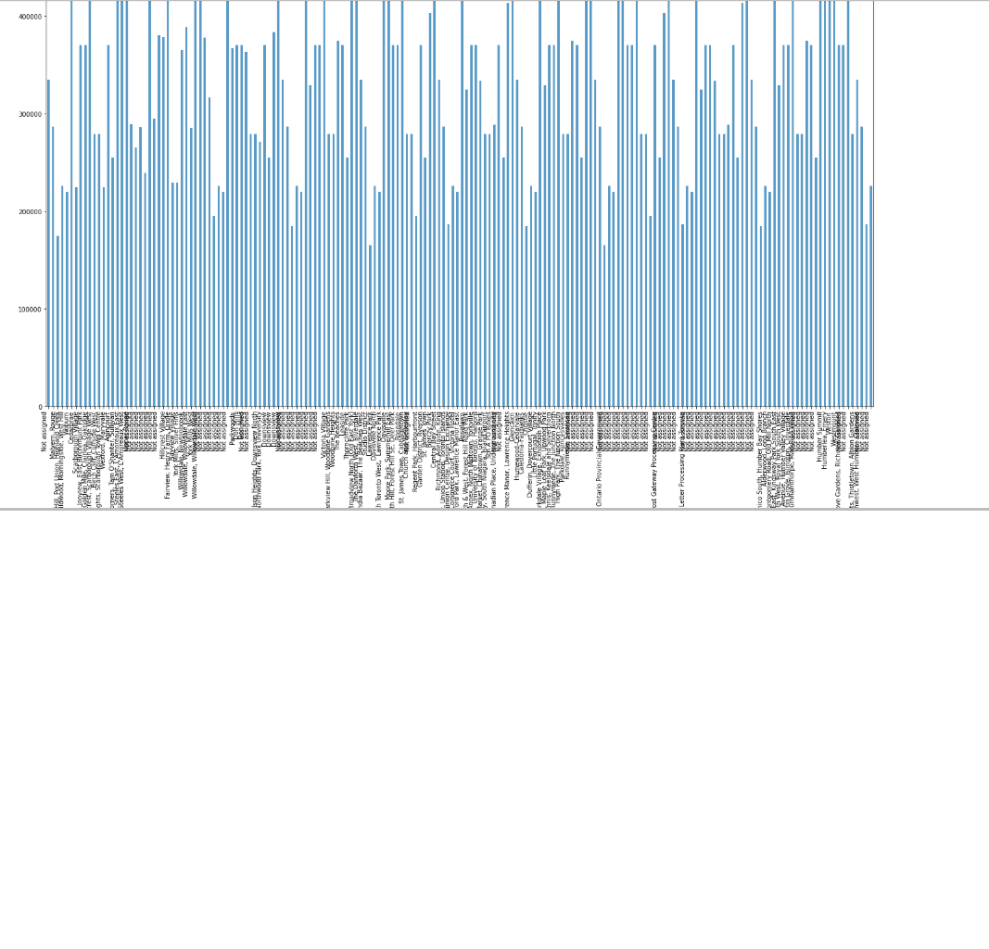
4. Results Section
a.) Average Housing Price by Clusters in Scarborough

Slide 10
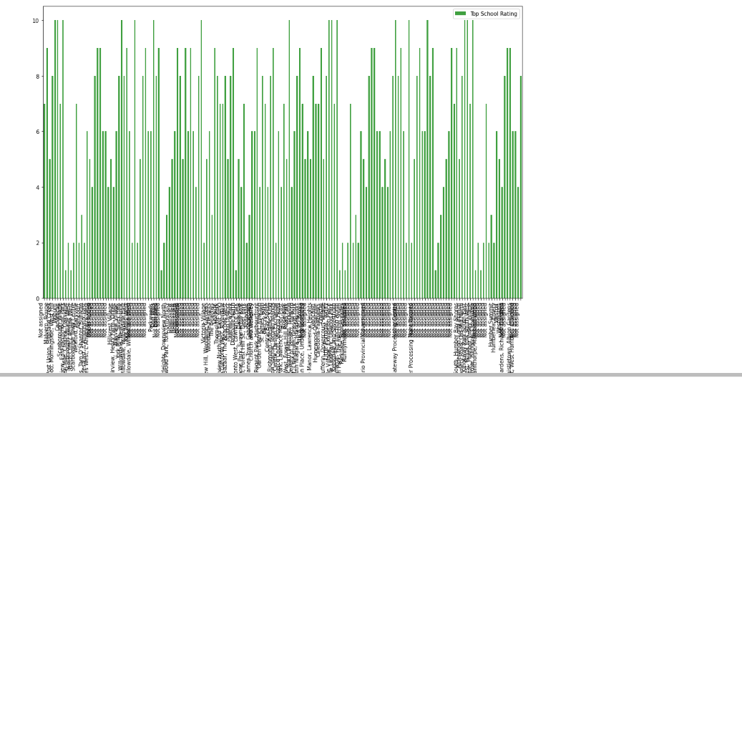
b.) Using K-Means Clustering Approach

Slide 11
5. Conclusion Section
The major purpose of this project, is to suggest a better neighborhood in a new city for the person who are shiffting there. Social presence in society in terms of like minded people. Connectivity to the airport, bus stand, city center, markets and other daily needs things nearby.
Sorted list of house in terms of housing prices in a ascending or descending order
Sorted list of schools in terms of location, fees, rating and reviews

